Slide 1

Storytelling Case Study: Airbnb, NYC
,,
Jjjm
Submitted by : Shashwat Avi
Dhruv Pathak
Rohan Tiwari
For Data Analysis Managers And Lead Data Analyst

Slide 2


Objectives
Understanding & Assumptions about of the Data
Background Summary
Important Findings
Appendix - Data Methodology
Team Background and Details

Slide 3

Enhance our all-around understanding of the effect of Covid-19 on economic and market essentials for the Airbnb Community.
Furnish details and gather insights to our Lead Data Analyst & Data Analysis Manager about the impact.
Improve our shared understanding of the challenges and gaps we faced during our Research phase and Data Preparation..

Slide 4
Assuming the sites hosted on the platform are not providing a better user experience to the end consumers and there could be another competitor capturing the market share
working on company's Data and taking access from the company for Data for analysis
The data provided is grasped from the Customer relationship management tool used by Airbnb to manage their customers that are hosting sites on their platform.
The examinations provided in the data frame are considered to be positive as it is not mentioned whether they are negative or positive reviews.

Slide 5
In the last few months, Airbnb has seen a major decline in revenue due to lockdown imposed during pandemic.
All the five neighborhood's borough (New York City) – the Bronx, Brooklyn, Manhattan, Queens and Staten Island – have contributed around $105 million in economic activity and supported 950 jobs in the outer boroughs past year-1.
Hence provided the report in hand based on previous data caught, we need to analyze the patterns for declining profits and recommend certain recommendations to overcome

Slide 6
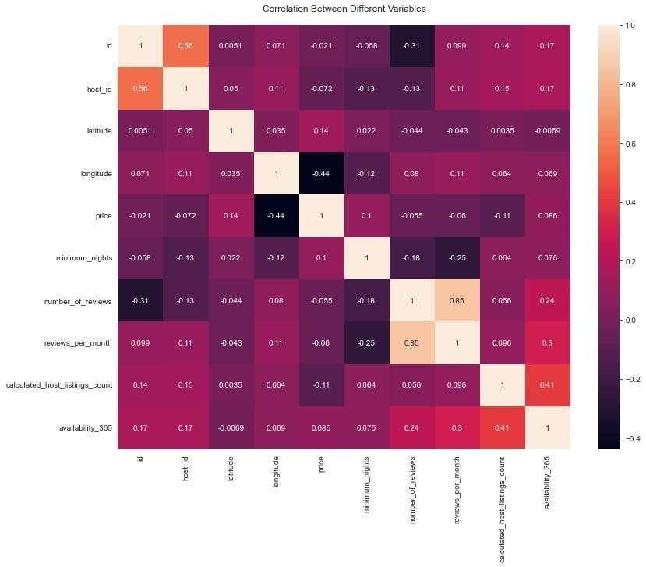
From Above Correlation plot we can say that there is no Strong Correlation between the Variables

Slide 7
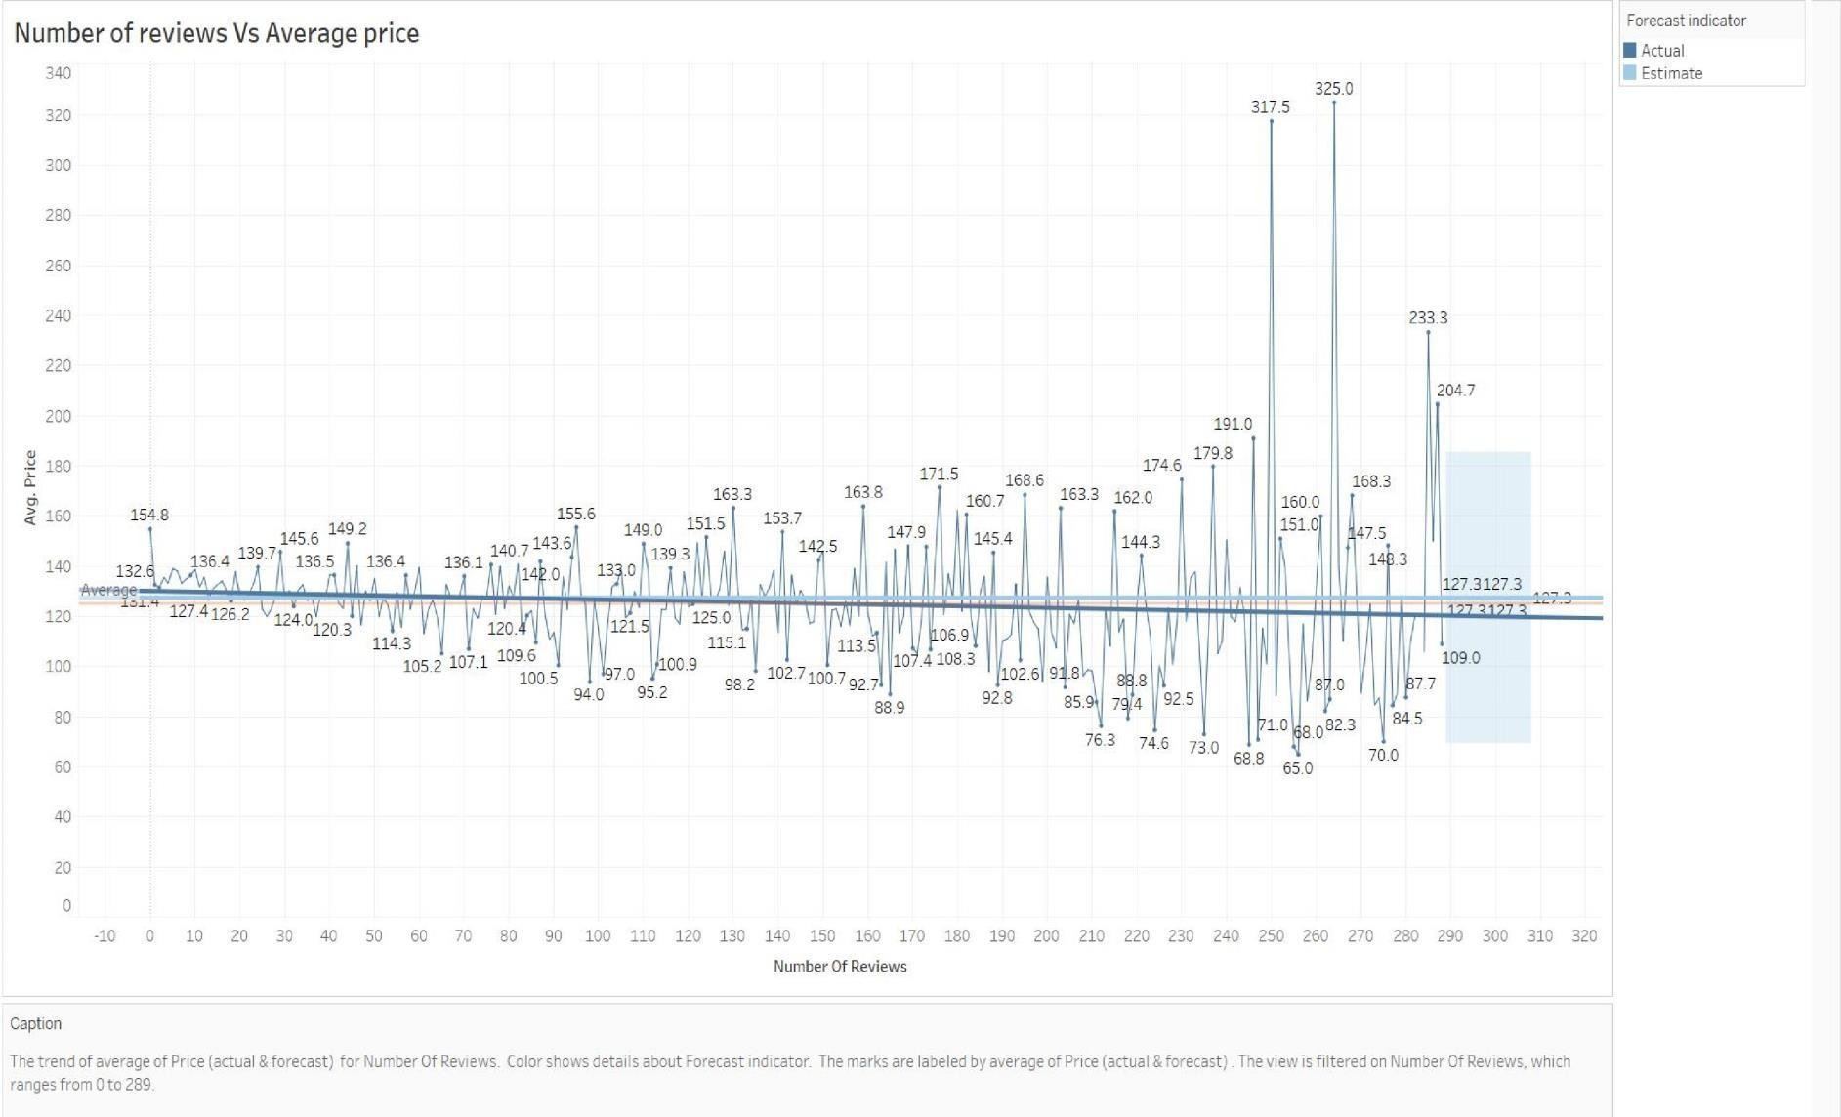

Slide 8

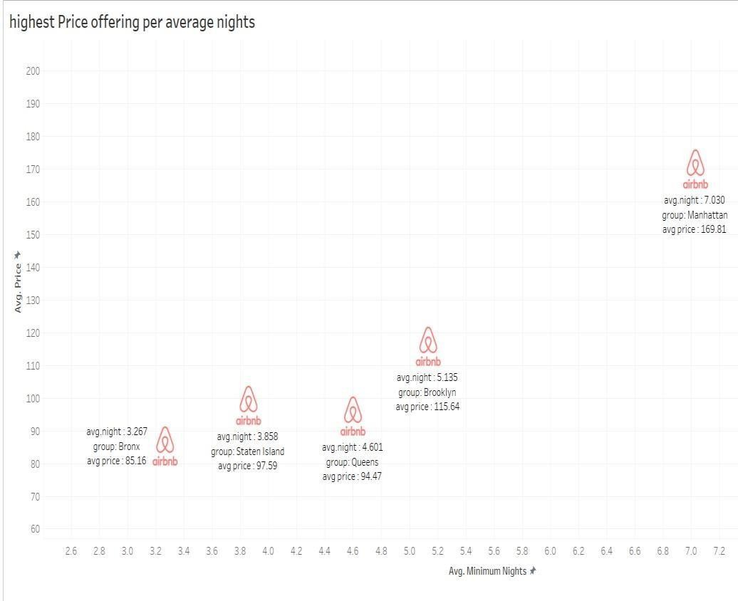
Manhattan is the only Neighborhood in the Borough that lies in offering the Highest Price range of properties on the platform followed by others with a Medium Price range on average. Prices offered above 120$ on average are a High Price, between 80$ to 120$, Medium Price range and less than 80$ to be considered Low Price range property.
Manhattan has the highest number of places listed around more than 10 by a single host with an average price of 230 $ followed by Brooklyn with an average price of 108$. On the other hand, all the hosts have less than 2 properties listed in either of the Borough on an average price range between 80 $ to 170 $.
The majority of the customers prefer a price range of 120$ to 130$ on average for a stay. As most of them have provided a good number of reviews within this price range. And it is forecasted to be at 126.83 $ in the upcoming future.

Slide 9

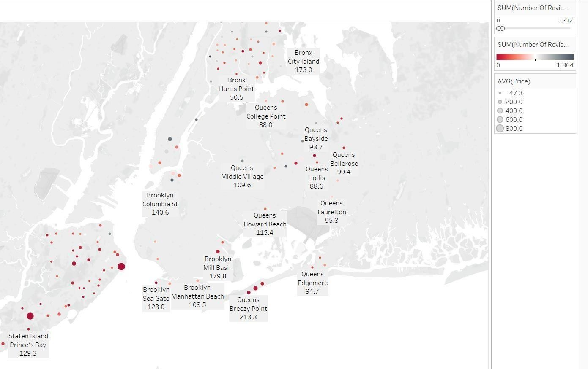
Staten Island - Silver Lake, Staten Island - Richmond town, Staten Island - Eltingville, Staten Island - Huguenot and Brooklyn - Manhattan Beach are the Top 5 locations with Low Price ranges that have received the highest number of reviews on average being the lowest in the Price range. On the contrary, Queens - Deposit, Manhattan - NoHo, Manhattan - Tribeca, Staten Island - Willow brook and Manhattan - Flatiron District is the highest in the Price range and have received a low number of reviews.

Slide 10
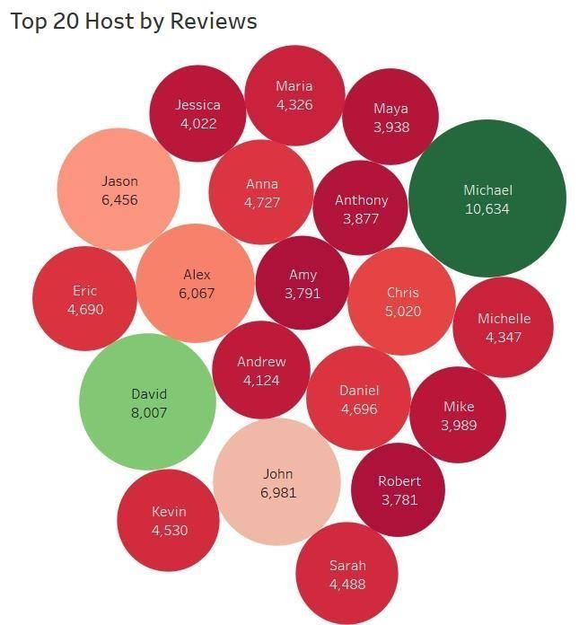
From Above chart we can say that - Top Location Based type of hosts are Michael, David, Alex, John and Daniel those seems to have received the highest number of reviews for their listed sites and have also sites listed with a High price range.

Slide 11

“WELCOME, TO BROOKLYN" PARKSIDE VIEW STUDIO APT", “Oasis on the Park”, “HELLO BROOKLYN"
PARKSIDE VIEW NEWLY RENO APT”, “Comfy Home Away From Home/Multiple rooms”, “LOVE
BROOKLYN" Newly Renovated Studio APT” and “Cozy Retreat" in North Crown Heights” are the Top 6 listed places that have received the highest number of reviews.
“Modern Duplex - Central Chelsea!!!” in Manhattan-Chelsea, “Spacious & Bright 3BRs Near Subways, Parks, Shops” in Brooklyn-Cobble Hill, “NYC LUXURY3 BEDROOMS IN MIDTOWN EAST & GYM&
BALCONY” in Manhattan-Murray Hill, “An Artist's Inspiration: Sun-Soaked Chelsea Loft” in Manhattan-Chelsea and “Upper West Side elegance. Riverside” in Manhattan-Upper West Side are the Top 5 hosted places with highest price offerings

Slide 12

1. Methodology Approach
a.
b.
c.
d.
e.
f.
g.
Research Problem Business Understanding Type of Data Require Data Source
Whom are we presenting? Analysis Done
Recommendations
2. Method of Analysis along with code
a.
b.
c.
d.
e.
f.
g.
Data Understanding and Preparation Variables overview
Handling missing values and outliers Feature selection / engineering Analyzing methods
Matrix used Analysis Evaluation of Methods
3. Training Methods:
a.
Python Using CRISP-DM methodology, Data Understanding, Pre- processing and general Univariate and Multivariate Analysis.
Tableau & Excel used for in-depth Bi-Multivariate AnalysisFinding and Insights
b.
5. Finding and Insights

Slide 13



